Slide 1
Data Driven Testing using Scenario Outline in Cucumber
Pre-Requisite
Cucumber – 6.10.4
Java – 11
Selenium – 3.141.59
Junit – 4.13.2 ( You can use TestNG also)
Cucumber JUnit – 6.10.4 (If using TestNG, then replace this with Cucumber TestNG)
In case, the project uses Maven, we need to add the below dependencies to the project.

Slide 2
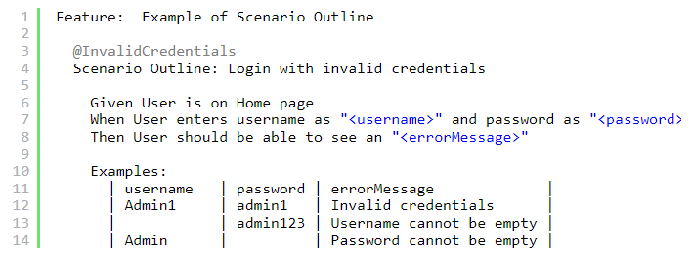
Data Driven Testing using Scenario Outline
Scenario Outline – It is used to repeat the same tests by passing different values or arguments to Step Definition
Examples – All scenario outlines have to be followed with the Examples section. This contains the data that has to be passed on to the scenario in Feature File.
We can repeatedly do something like the above and check for each parameter that we want to test, but that will make tests hard to maintain with many repetitions. Instead, we can use a Scenario Outline to add different inputs or arguments to the same scenario.

Slide 3
Note:- The table must have a header row corresponding to the variables in the Scenario Outline steps.
The Example’s section is a table where each argument variable represents a column in the table, separated by “|”. Each line below the header represents an individual run of the test case with the respective data. As a result, if there are 2 lines below the header in the Examples table, the script will run 2 times with its respective data.
When Cucumber starts to run this program, first, it will map parameters from the data table to placeholders like, and soon in the Feature File. The corresponding StepDefinition of Feature file is mentioned above. The steps can use delimited parameters that reference headers in the examples table. The cucumber will replace these parameters with values from the table before it tries to match the step against a step definition.

Slide 4
DataTables in Cucumber
Cucumber Data Tables can be used to add multiple parameters in Step Definition in a tabular form rather than putting all the parameters in the Gherkin statement. This is much easier to read and multiple rows of data can be passed in the same step. Data tables from Gherkin can be accessed by using the DataTable object as the last parameter in a Step Definition
Pre-Requisite
Cucumber – 6.10.4
Java – 11
Selenium – 3.141.59
Junit – 4.13.2 ( You can use TestNG also)
Cucumber JUnit – 6.10.4 (If using TestNG, then replace this with Cucumber TestNG)

Slide 5
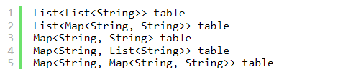
Depending on the table shape, we can use one of the following collections:
1. Table into List of a List of Strings
| firstName | lastName | age |
| Thomas | Brown | 30 |
| Perry | Wilson | 26 |
| Ashley | William | 27 |
java type: List<List<String>>
The natural representation of list of a list of strings is shown below.
[
[ "firstName", "lastName", "age" ],
[ "Thomas", "Brown", "30" ],
[ "Perry", "Wilson", "26" ],
[ "Ashley", "William", "27" ]
]

Slide 6
2. Table into List of Maps
java type: List<Map<String, String>>
The natural representation of list of maps is shown below.
[
{ "firstName": "Thomas", "lastName": "Brown", "age": "30" },
{ "firstName": "Perry", "lastName": "Wilson", "age": "26" },
{ "firstName": "Ashley", "lastName": "William", "age": "27" }
]
3. Table into Single Map
Table where first column is key as shown below
| IN | India |
| IRE | Ireland |
java type: Map<String, String>
TO convert the table into a single map
{
"IN": "India",
"IRE": "Ireland"
}

Slide 7
4. Table into map that uses a list as its value
A table with multiple column values per key.
| IN | India | 29 |
| IRE | Ireland | 8 |
java type: Map<String, List<String>>
{
"IN": ["India","29"],
"IRE": ["Ireland","8"]
}

Slide 8
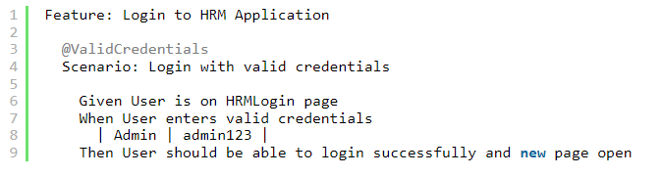
Cucumber Data Tables Example in Java
Data Table without Header Example
Below is an example of how to implement Data Tables without a Header. For example, we want to test the Login Page of an application. We can either mention all the arguments inside the Gherkin statement or use a table to list all the arguments, as we used below:

Slide 9
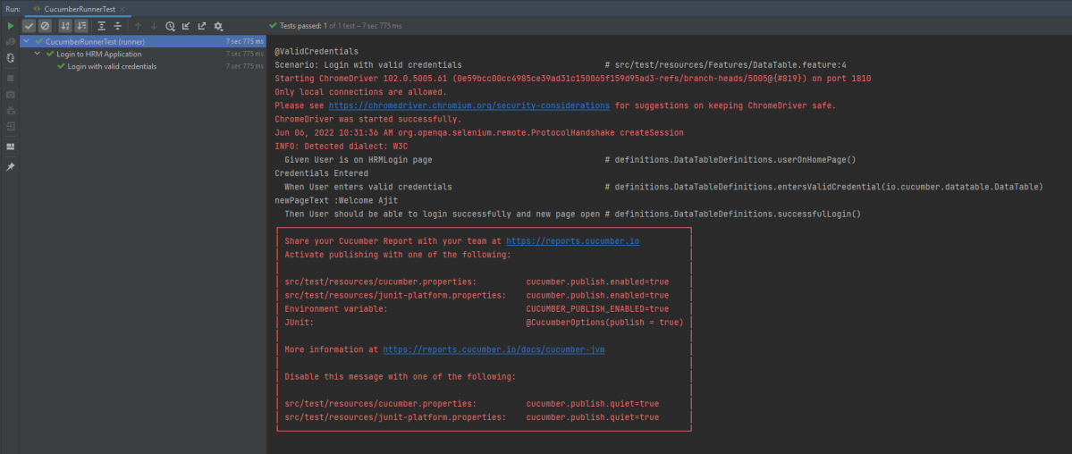
The output of the above program is

Slide 10
In the above example, as we don’t have a header, we have just got the List object and get the values of DataTable starting from 0 index.
Cucumber converts the above table into a list of lists by treating each row as a list of the column values. We use the asLists method — supplying a String.class argument — to convert the DataTable argument to a List<List<String>>. This Class argument informs the asLists method of what data type we expect each element to be.
Data Table with Header and Single Row Example
Below is a cucumber data tables example with the header.
Adding a header to your table makes it easier to read and maintain.
@InValidCredential
Scenario: Login with invalid credential
Given User is on HRMLogin page
When User enters invalid credentials and Login will be unsuccessful with error message
| Username | Password | ErrorMessage |
| Admin1 | admin123!$ | Invalid credentials |

Slide 11
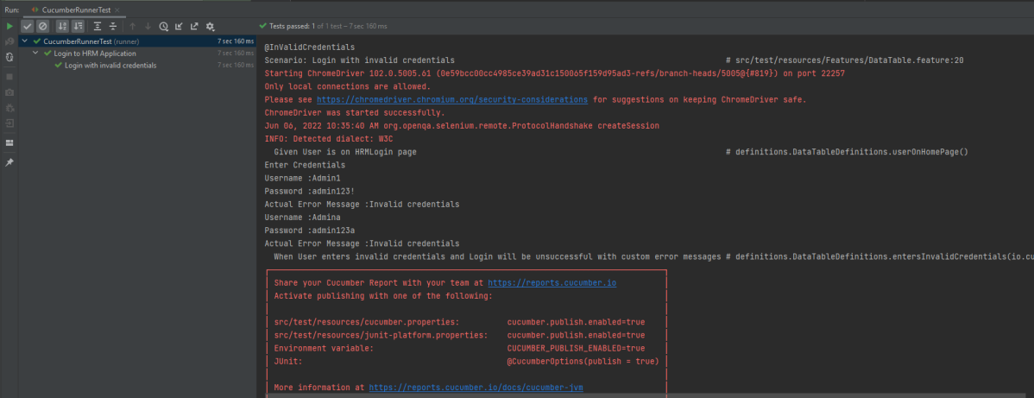
The output of the above program is
Cucumber creates a list containing each row, but instead maps the column heading to each column value. Cucumber repeats this process for each subsequent row. We use the asMaps method — supplying two String.class arguments — to convert the DataTable argument to a List<Map<String, String>>.
The first argument denotes the data type of the key (header) and the second indicates the data type of each column value. Thus, we supply two String.class arguments because our headers (key) and title and author (values) are all Strings.

